Slide 1
Introduction to Data Storage Systems
Team name: PebblesDB
Member: 110368151 呂彥旻
110268035 何翊宇

Slide 2
PebblesDB: Building Key-Value Stores using Fragmented Log-Structured Merge Trees
Pandian Raju, Rohan Kadekodi, Vijay Chidambaram, and Ittai Abraham. Pebblesdb: Building key-value stores using fragmented log-structured merge trees. In Proceedings of the 26th Symposium on Operating Systems Principles, pages 497–514. ACM, 2017.

Slide 3
Outline
Introduction
Log-Structured Merge Tree (LSM)
Fragmented Log-Structured Merge Trees (FLSM)
Building PebblesDB using FLSM
Evaluation
Conclusion

Slide 4
Introduction
Key-value stores is the infrastructure of our common system nowadays.
The key could be anything, but it needs to be unique in the database.
The value could be anything, including a list or another key-value pair.
Keys
Values
1234
{Name: Jean Grey, Country: USA}
1235
{Name: Tom, Country: ROC}
Pandian Raju, Rohan Kadekodi, Vijay Chidambaram, and Ittai Abraham. Pebblesdb: Building key-value stores using fragmented log-structured merge trees. In Proceedings of the 26th Symposium on Operating Systems Principles, pages 497–514. ACM, 2017.

Slide 5
Introduction (Cont’d)
Key-value stores are widely used in databases for search, analysis, and maps.
Log-Structured Merge Tree (LSM) is a write-optimized data structure used in key-value stores.
Use the Fragmented Log-Structured Merge Tree (FLSM-Tree) data structure to avoid rewriting data at the same level.
FLSM can be seen as a blend of an LSM data structure with a skip list and a novel compaction algorithm that reduces write amplification and increases write throughput.
Pandian Raju, Rohan Kadekodi, Vijay Chidambaram, and Ittai Abraham. Pebblesdb: Building key-value stores using fragmented log-structured merge trees. In Proceedings of the 26th Symposium on Operating Systems Principles, pages 497–514. ACM, 2017.

Slide 6
Log-Structured Merge Tree (LSM)
LSM increases bandwidth by sequentially writing to memory. Writes are processed in batches in memory and written to as sequential logs (SSTable).
When Level 0 goes to merge Level 1, after each merge, all SSTables in the next level that intersect with the compressed SSTables are rewritten.
Pandian Raju, Rohan Kadekodi, Vijay Chidambaram, and Ittai Abraham. Pebblesdb: Building key-value stores using fragmented log-structured merge trees. In Proceedings of the 26th Symposium on Operating Systems Principles, pages 497–514. ACM, 2017.

Slide 7
Log-Structured Merge Tree (LSM) (Cont’d)
The figure shows SSTables being inserted and compacted over time in a LSM.
250, 550
Memory
Immutable Table
Storage
Level 0
10, 210
250, 550
10, 210
500, 550, 600
200, 210, 250, 400
500, 550, 600
1, 100
200, 210, 250, 400
200, 210, 400
1, 10, 100
200, 400
500, 600
Level 1
1, 10, 100
Pandian Raju, Rohan Kadekodi, Vijay Chidambaram, and Ittai Abraham. Pebblesdb: Building key-value stores using fragmented log-structured merge trees. In Proceedings of the 26th Symposium on Operating Systems Principles, pages 497–514. ACM, 2017.

Slide 8
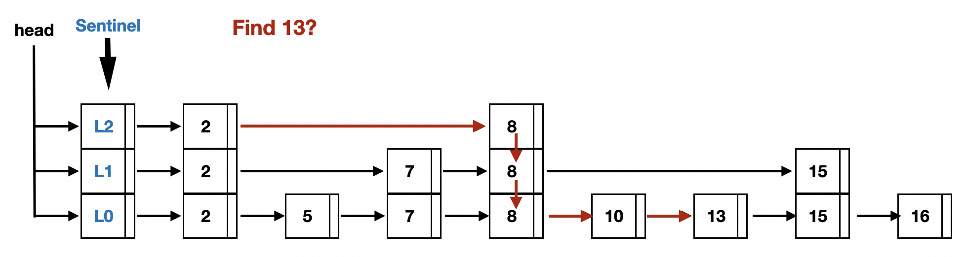
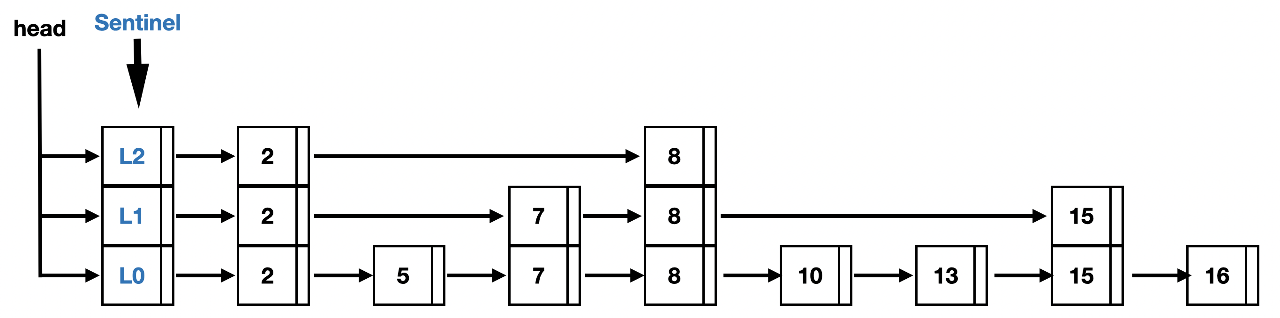
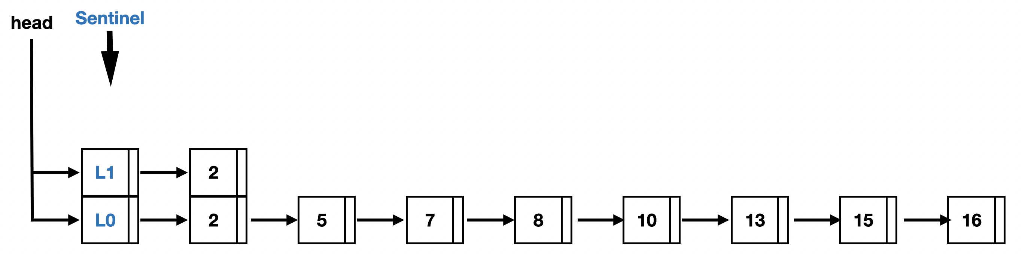
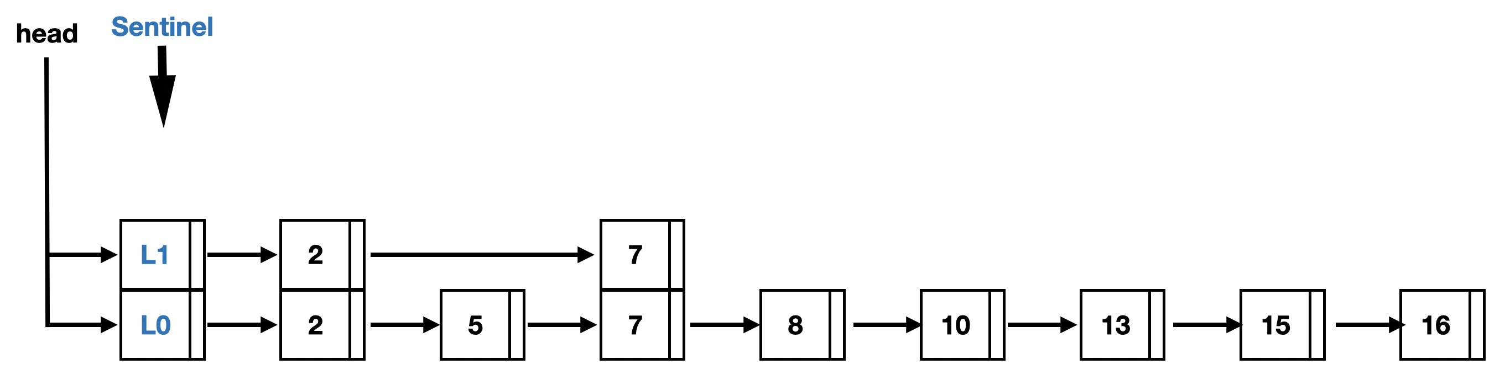
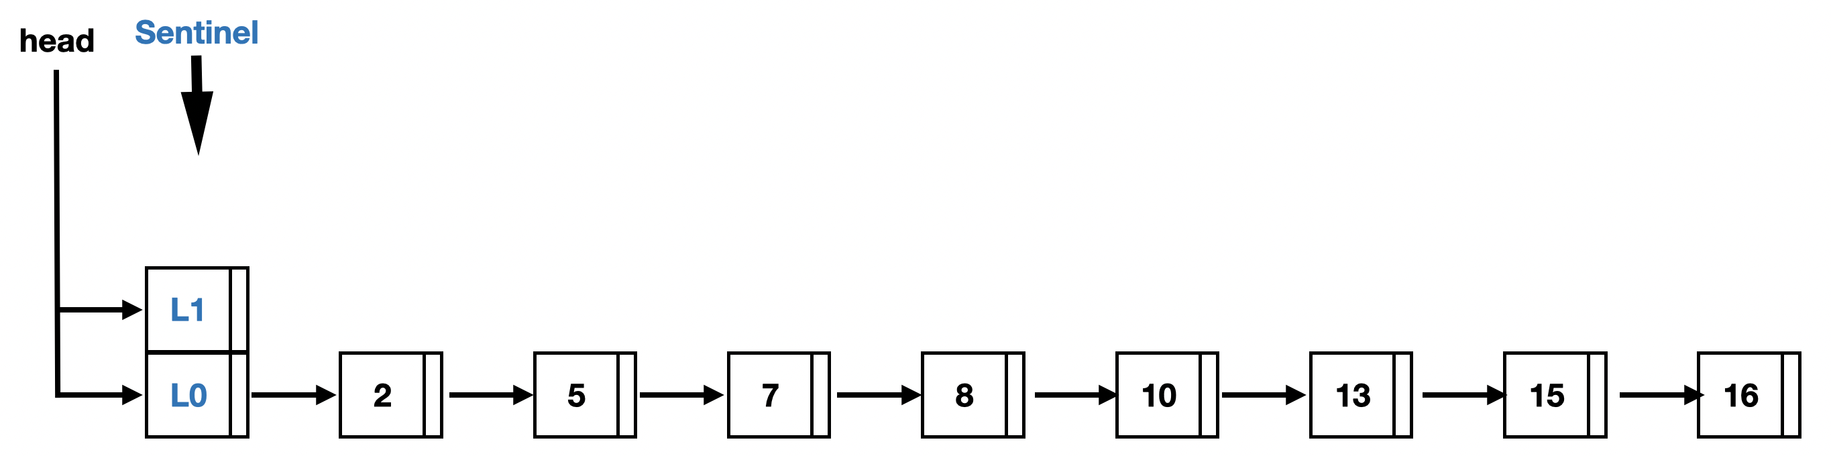
Fragmented Log-Structured Merge Trees
FLSM inspired by skip list data structure.
Introduction skip lists.
Pandian Raju, Rohan Kadekodi, Vijay Chidambaram, and Ittai Abraham. Pebblesdb: Building key-value stores using fragmented log-structured merge trees. In Proceedings of the 26th Symposium on Operating Systems Principles, pages 497–514. ACM, 2017.
https://hackmd.io/@mam8t5W3TIuMwYqnndsBQQ/rJ_Tyq5wq

Slide 9
Fragmented Log-Structured Merge Trees (Cont’d)
Each level contains multiple guards. Guards divide the key space (for that level) into disjoint units.
Through the guard mechanism, we can effectively control the range of keys in the SSTable.
Inserting a guard requires splitting an SSTable or moving an SSTable.
When guards are deleted you need to wait until compaction.
Pandian Raju, Rohan Kadekodi, Vijay Chidambaram, and Ittai Abraham. Pebblesdb: Building key-value stores using fragmented log-structured merge trees. In Proceedings of the 26th Symposium on Operating Systems Principles, pages 497–514. ACM, 2017.

Slide 10
Fragmented Log-Structured Merge Trees (Cont’d)
Get Operations: You can find guard faster, and then find whether there is a key to search for in the SSTable.
Range Queries: The FLSM mechanism will first search for a given range of guards, and within each guard, there will be multiple SSTables for sorted lookup.
Key Updates and Deletions: If the insertion of key results in the formation of a guard, the deletion of a key does not result in the deletion of the associated guard.
Compaction: The SSTable in guard will be sorted first, and then sorted according to the next level of guard, and will be split into new SSTable if needed.
Pandian Raju, Rohan Kadekodi, Vijay Chidambaram, and Ittai Abraham. Pebblesdb: Building key-value stores using fragmented log-structured merge trees. In Proceedings of the 26th Symposium on Operating Systems Principles, pages 497–514. ACM, 2017.

Slide 11
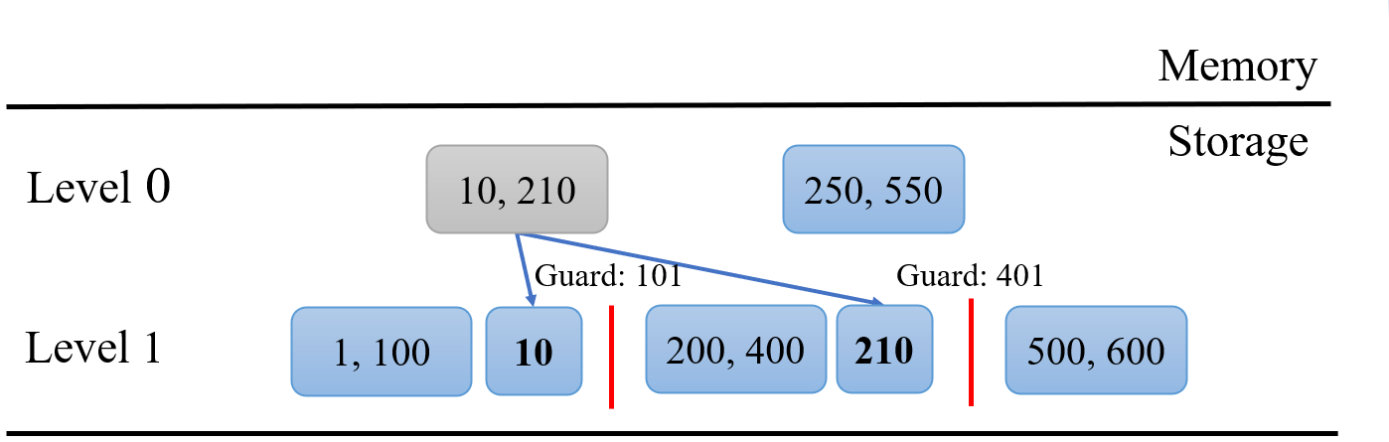
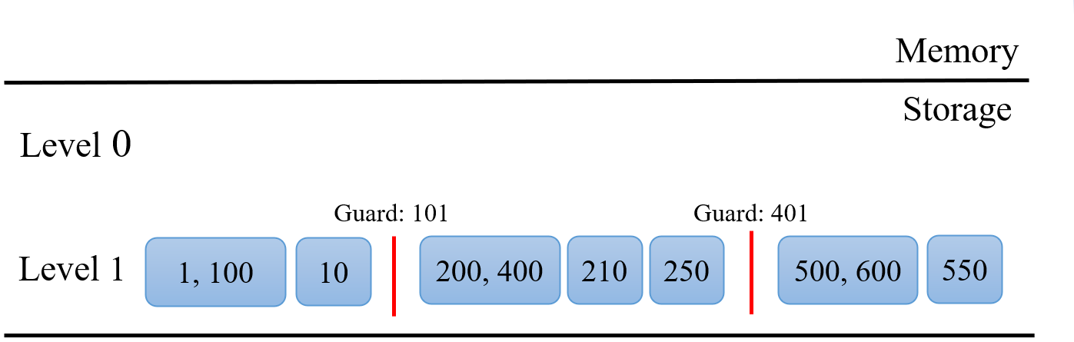
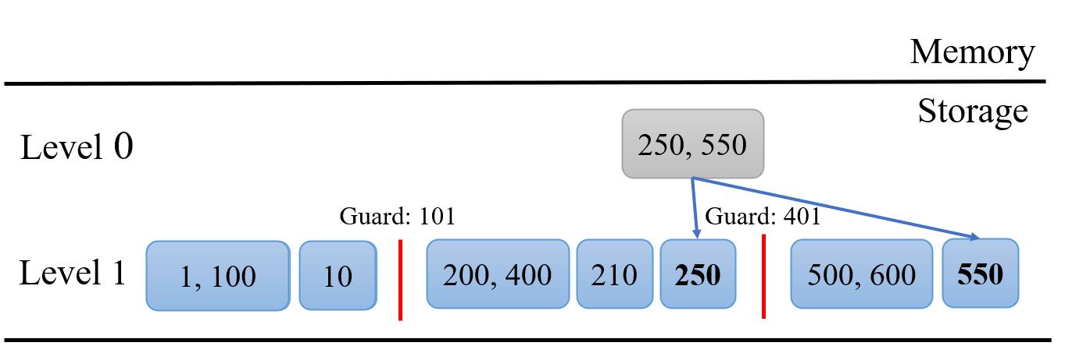
Building PebblesDB using FLSM
The figure shows SSTables being inserted and compacted over time in a FLSM.
250, 550
Memory
Immutable Table
Storage
Level 0
10, 210
Guard: 101
Guard: 401
Level 1
1, 100
200, 400
500, 600
Pandian Raju, Rohan Kadekodi, Vijay Chidambaram, and Ittai Abraham. Pebblesdb: Building key-value stores using fragmented log-structured merge trees. In Proceedings of the 26th Symposium on Operating Systems Principles, pages 497–514. ACM, 2017.

Slide 12
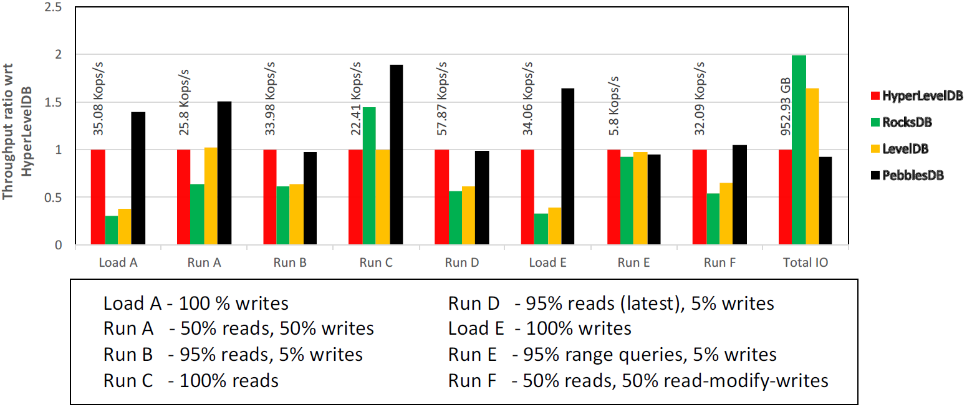
Evaluation
The figure shows the throughput of different key-value stores on the YCSB benchmark suite run with four threads.
Pandian Raju, Rohan Kadekodi, Vijay Chidambaram, and Ittai Abraham. Pebblesdb: Building key-value stores using fragmented log-structured merge trees. In Proceedings of the 26th Symposium on Operating Systems Principles, pages 497–514. ACM, 2017.

Slide 13
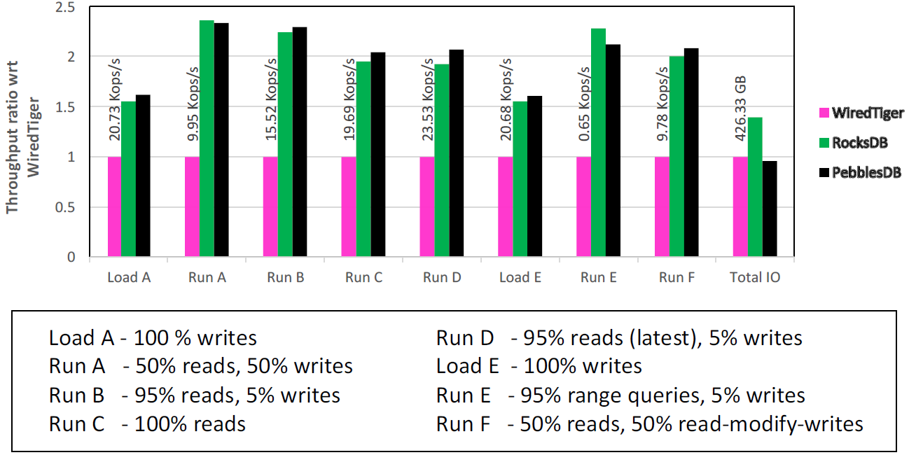
Evaluation (Cont’d)
The figure shows the YCSB throughput of the MongoDB NoSQL store when using different key-value stores as the storage engine.
Pandian Raju, Rohan Kadekodi, Vijay Chidambaram, and Ittai Abraham. Pebblesdb: Building key-value stores using fragmented log-structured merge trees. In Proceedings of the 26th Symposium on Operating Systems Principles, pages 497–514. ACM, 2017.

Slide 14
Conclusion
The design of the novel FLSM data structure combines ideas from skip lists and log-structured merge tree.
Experimental results demonstrate that PebblesDB dominates LSM-based stores in many workloads.
PebblsesDB is a high-performance key-value store that achieves low write amplification, high write throughput, and high read throughput simultaneously.
Pandian Raju, Rohan Kadekodi, Vijay Chidambaram, and Ittai Abraham. Pebblesdb: Building key-value stores using fragmented log-structured merge trees. In Proceedings of the 26th Symposium on Operating Systems Principles, pages 497–514. ACM, 2017.

Slide 15
Thank You!
Questions & Answers

